Slide 1

Introduction to Atliq Hospitality Data Analysis
This report delves into data analysis within Atliq Hospitality. We will explore various datasets that offer insights into operations, bookings, and hotel performance. Understanding these data points is crucial for strategic decision-making and improving customer experience.
by Sachin

Slide 2
Overview of Datasets
Dim_Date
Dim_Hotels
Dim_Rooms
This dataset includes all dates relevant to the hospitality industry. It enables temporal analysis of bookings.
Information on various hotels like location and pricing. Critical for market comparison.
This dataset describes room types and attributes, assisting in inventory management.

Slide 3

Exploration of Dim_Date Dataset
1
Date Range
The Dim_Date dataset covers a comprehensive date range for analysis.
2
Seasonality
It helps identify peaks and lows in bookings, revealing seasonal trends.
3
Event Tracking
Special events can be tracked to analyze their impact on hotel bookings.

Slide 4

Analysis of Dim_Hotels Dataset
1
Diverse Properties
The dataset includes various types of hotels from budget to luxury.
2
Geographical Insights
Understanding market saturation in different locations can enhance strategy.
3
Performance Metrics
Key metrics provide insights on hotel performance relative to competitors.

Slide 5

Insights from Dim_Rooms Dataset
Room Type
Max Occupancy
Price per Night
Standard Room
2
$100
Deluxe Room
3
$150
Suite
4
$250

Slide 6




Fact_Aggregated_Bookings Dataset Insights
Monthly Insights
Analysis reveals booking trends over months.
Occupancy Rates
Shows how occupied rooms affect revenue.
Guest Demographics
Understanding demographic details can optimize marketing efforts.

Slide 7
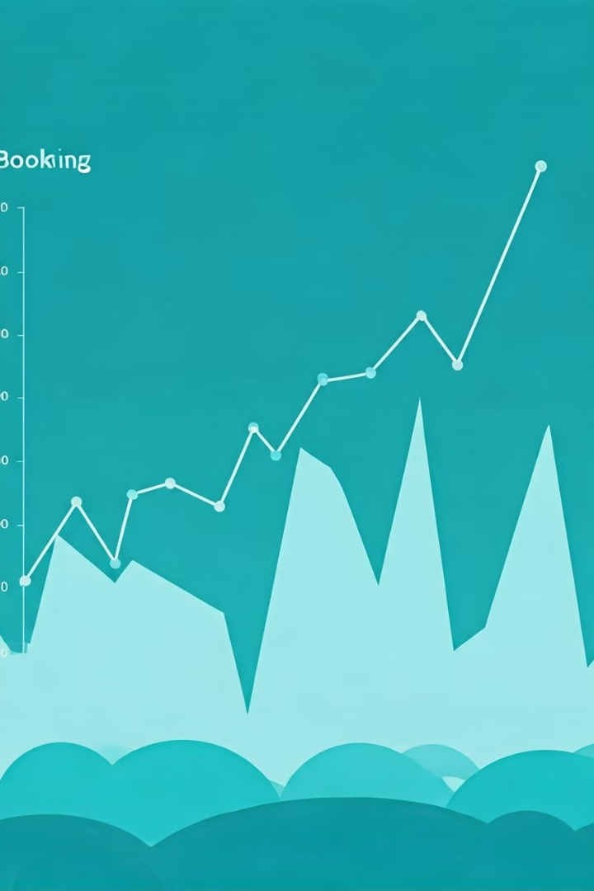
Fact_Bookings Dataset Trends
1
Peak Seasons
Identifying peak booking seasons to maximize revenue.
2
Booking Lead Time
Analysis of how far in advance guests book.
3
Cancellation Rates
Understanding cancellation trends helps in risk management.

Slide 8

Conclusion and Key Findings
The analysis of Atliq Hospitality data yields actionable insights. Understanding datasets aids in making informed decisions that enhance operations. Continuous monitoring of these metrics is essential for future success in the hospitality industry.

